Slide 1
Visionary workshop: Approaches to Digital
Presented by:
Katherine Hughes, RNIB Senior Social Media Manager
Lizzi Wagner, RNIB Senior Challenge Events Manager

Slide 2

Digital is all around us
Notes:
Just because we don’t have digital in our job titles doesn't mean we shouldn’t be thinking about digital all the time, because it’s now so fundamental to how we all live our lives.
Katherine and I talking from two different perspectives and how we approach digital, Katherine from social media and me from fundraising challenge events
In challenge event fundraising digital encompasses everything we do to raise money:
How we recruit fundraisers – digital marketing are the key channels
How we sign people up – sign up journeys online
How we steward and support fundraisers – main channel via email
How we raise the money – majority of funds raised via online fundraising pages and come via share on social
How we share our participant stories – largely online media coverage and social media
Today focusing on virtual challenge events and sharing learnings on our digital marketing and acquisition/sign up journeys for these digital products

Slide 3
Virtual challenge events: Market insight
£1 million raised in 2015 on JustGiving, £12 million raised in 2019
Approx. £50 million so far in 2020
Already a growing market, but exploded due to coronavirus
  Increased opportunity and competition
Only 16% were already planned
82% of all new virtuals since April involved physical activity
£200 average fundraising per person
Online fitness has also hugely grown
  92% increase in Couch to 5K downloads, over 858,000 new users between March and June
  50,000 JustGiving pages linked to Strava since April
  40 million YouTube video fitness hits in April alone
Notes:
Add stats from Massive
45% Were new campaigns launched in response to the pandemic
38% Were pivots of planned events that were unable to take place
16% Were existing campaigns already planned or upweighted to take advantage of the situation
82% Involved physical activity
37% Run
24% Pick your own
22% Walk
9% Cycle
1% Climb
7% Non-physical events
Run £124 Walk £156
Climb £294 Cycle £226
Run £124 Walk £156
Climb £294 Cycle £226
£205 - Hard
£180 – Medium
£174 - Easy
37% Run
24% Pick your own
22% Walk
9% Cycle
1% Climb
7% Non-physical events
• 36% allowed participants to pick their own distance
• 25% offered a limited choice
• 39% set a specific challenge

Slide 4

Virtual challenge events: Who’s doing it well
British Red Cross - Miles for Refugees
£27,000 raised in Year 1, up to £285,000 in Year 3
Year 4 has raised £2m, with over 7,000 sign ups
Directly links to mission
Sign up via JustGiving
miles.redcross.org.uk/
Notes:
Slide notes:
Fundraisers pick a distance to walk, run, cycle or swim over a month, which represents a part of the journey a refugee would make to reach safety.
Why this is a great example
Directly links to the charity mission
Gives options, attracting different fitness abilities but doesn’t make it too broad
Simple adverts/marketing
Targeted warm supporters and colder health & fitness audiences
Other great example – Marathon in a month/Children with bone cancer

Slide 5
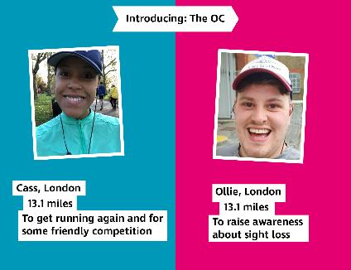
Virtual challenge events: What we’re doing at RNIB
Launched Marathon Mates
  Planning: March to June
  Recruitment: July to August
  Event month: September
Inspired by relationship of VI runners and guide runners
Accessibility and inclusivity
230 people took part
£38,000 raised
£165 raised per person
2 million media reach
marathonmates.rnib.org.uk/

Slide 6
Key digital marketing channels and tools
Website
Facebook
Search
Display
Email
Google analytics
Facebook analytics
Notes:
Website/landing page
This is your shop front, you want as much engaging content on there as possible to keep people browsing & ultimately convince them to get involved
Sign up buttons are clear and obvious
Include real supporters and their stories as much as possible
Facebook
Identify key target audiences, e.g. people interested in sight loss or health and fitness
Tested different copy & call to actions
Tested different images & videos
Most successful videos & images were the cheapest ones that we asked staff to produce, talking into camera whilst running
Search marketing
Identified key word list of search terms that people were likely to google for a virtual challenge, or if they were interested in a running challenge or fitness, e.g. ‘virtual running event’, ‘running’, ‘virtual challenge’
Made sure these key words also included within the copy on our webpage
Make the most of the free Google Grant for AdWords
Display
- Tested small budgets on display marketing, targeting people who were visiting health and fitness sites, first time we’ve done this and it was our third most successful traffic driver to the website
Email
Series of emails to past challenge event supporters last 3 years with consent to contact by email
This activity drove traffic to the website, but resulted in only small number of direct conversions & wasn’t a huge success
Google and Facebook analytics
Look at this everyday to understand how your webpage and your social media activity is performing
How many people are visiting and what marketing channels are they coming from
How much time are people spending on your webpage, can you think of ways to get people to stick around for longer by adding more engaging content

Slide 7
Virtual challenge events: key takeaways
Think carefully about your sign up process
Imagery can be simple, e.g. two pairs of trainers, selfie stock images, pair of legs running,
Gather supporter generated images and videos
Use Google Grant AdWords opportunity
Test small budgets on Facebook marketing
You don’t need big budgets and lots of time
Notes:
Sign up process
We usually use standard donation forms to sign up challenge event supporters because people usually pay an entry fee & we work with a company called Committed Giving.
For Marathon Mates, because it was free, for the first time we ran our sign up directly via JustGiving, so sign up for the event and setting up a fundraising page were combined.
Some issues with this, our conversion rate was low, couldn’t track all analytics, only contact details collected, and made more complicated by people taking part in pairs
Next year we are going to test signing people up via our standard donation form, and ask them to set up a fundraising page afterwards
Another simple option is event sign up form via Facebook – Marathon in a Month Children with Bone Cancer – used simple FB form and then added people to FB group, people were then asked to set up a fundraising page by emailing the events email with the link and their t-shirt size
Keep the amount of sign up information to absolute minimum, to make the process as quick as possible
Keep mobile in mind and review and test your sign up on mobile - 89% of our website visits were from mobile
Digital marketing content
If you don’t have any real images to use for adverts, just use stock images to start with, but start to replace these images with real people as they sign up
Ask everyone who signs up to share pictures of themselves and ask for consent to use in marketing
Facebook marketing
Test it out and see what works
Big budgets not required
Come up with an idea
Get people to sign up by setting up a JustGiving page or via Facebook
Create a campaign page on JustGiving so all your supporters are linked together
And you’re away
HAND OVER TO KATHERINE

Slide 8
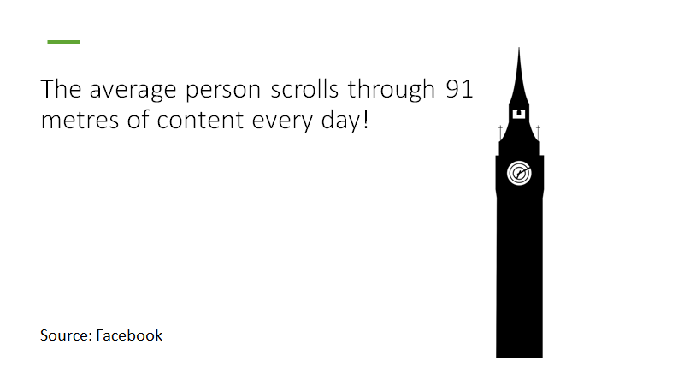
Fundraising through social media
Notes:
That’s the height of Big Ben. What can you do to stand out amongst that?

Slide 9





Social Media Platforms
Notes:
We use a wide range of channels to help us achieve our objectives (including fundraising)- Facebook (including groups), Twitter, Youtube, Instagram and Linkedin.
Nearly 9 in 10 of us have used one or more of the above social media platforms in the last 30 days.
Social media is broadly used whatever your age.
We use these channels to support RNIB’s core objectives through proactive and reactive content, as well as working to protect and promote our brand and reputation. Promotions (both planned and reactive) are the majority of what we do across our social media channels. Not just fundraising but also campaigning, awareness raising, showing our impact.

Slide 10
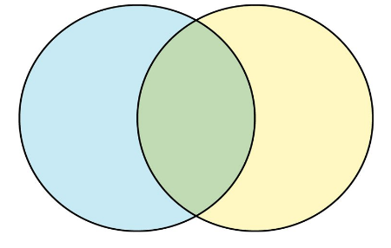
What people want to hear from us
What we want to say
Notes:
What people want to hear from us - latest news linked to sight loss, opportunities to be heard and share their experiences, inspiring stories. We know what people want to hear from us from close analysis of detailed data and evaluations. We are always evolving and developing our approach based on what we know is working well for our audiences.
what we want people to hear – As with most big, complex organisations there is a lot going on at all times. This means the team must be disciplined with what we say and when (applying the above insight of what our audience want from us). Social Media team are experts in weighting up the balance to ensure we can support organisational priorities by promoting our services, campaigns, fundraising activity, brand building and sharing what people can do to support us in an engaging and compelling manner.
The challenge is to strike the right balance between the two: currently aiming for 80% adding value and ‘non selling’ and 20% promotional, but we don’t always get this balance right when focus on internal priorities over the external environment, > Venn diagram: content ‘sweet spot’ is the middle green section > UGC that supports fundraising activities, informal videos breaking down the impact of campaigns etc without alienating our core audience.

Slide 11
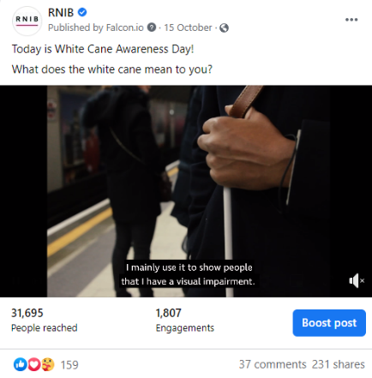
Brevity
Notes:
keep audience wanting more,
writing copy: still aim for 140 of even less. Always the shorter the content, the more effective it can be. Always look at how you can you reduce copy down as that helps you grab attention, stand out, be more sharable to reach new audiences > all things that will help you reach your fundraising goals

Slide 12
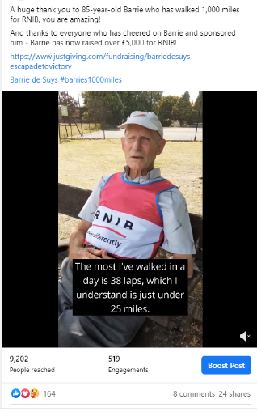
Facebook
Image/video led
Focus is increasingly on community and connections.
Meet people where they are & where you can add value to conversations
Facebook Fundraisers
People don’t want to be told what to do: inspire them.
Test and adapt, vary content types
Authenticity is key.
Notes:
Visual channel. Much like other social platforms – images / video will grab attention more than a block of copy. 95% of content is delivered on mobile - make images and videos portrait
TARGET - look at your audience, who are they, what will they connect to? Meet them where they are at: Facebook Fundraisers for birthdays etc.
INVEST – you can tell the same story in many different ways, make sure you invest time and energy into making a story as powerful as possible.
MOTIVATE – Use values in these storytelling people can relate to.
TEST – Break up your feed – keep it fresh and exciting
Try new things
Don’t be afraid to fail.
BE AUTHENTIC – If our audience don’t trust us, they wont engage with us. Human-led, person centred, try not to be corporate. Live content x7 engagement – rough and ready, less polished, more human.

Slide 13
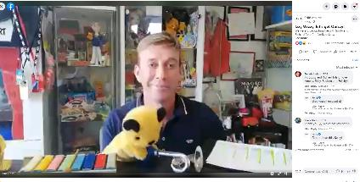
Facebook Live
Live content achieves higher engagement rates than other content.
Relaxed and informal.
Timely and sends a notification to all followers.
Audiences are motivated to engage more by commenting and asking questions as the time is limited.
An account will receive 3 times more engagements after they have gone live.
Notes:
7x engagement rate for lives
Facebook Live is great for fundraising: use it to launch an appeal, do a q+a with an expert that ends with a CTA to donate, host a fundraiser like our quiz for children back in the summer.
Don't need much equipment: a confident presenter, a mobile phone (fully charged), internet connection and ideally a quiet space. If you have budget a tripod is great for keeping the camera still, but if not then you can balance it on some books or hold it selfie style.
Top tip: to create a hidden page to test going live on before you really do. You can check everything looks and sounds okay before the big broadcast.

Slide 14
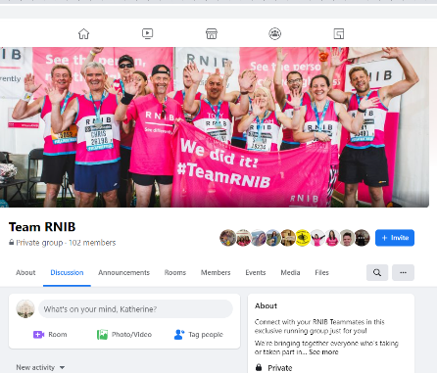
Facebook Groups
200m people globally in ‘meaningful’ community groups
Notes:
Most of the 14+ Facebook Groups we have at RNIB are focussed on peer support and community connection, but we also have a small number that bring together our fundraisers. Specifically, challenge events participants like London Marathon runners. These private groups provide a space for supporters to share training advice, support each other and develop their connections to RNIB. They are also a great place to source UGC – this kind of content is so authentic and engaging, and doesn’t take much time to sort out and provides great assets for marketing your fundraising events.

Slide 15
Algorithm
Timing is crucial
Content cannot feel like advertising or Facebook will restrict reach. Avoid anything too branded, too corporate or images that contain too much text (20% rule).
Links that direct people out of Facebook will also reduce the reach of a post.
Encourage interaction.
Post that have consistently similar messages flagged as ‘repetitive’ and reach declines. Avoid repeating words/phrases like: “sight loss”, “thanks”, “make a difference”
Avoid: “Shop”, “sale”, “buy”, “purchase”, “offer”, “please like/share/comment”.
Notes:
ALGORITHM
The set of rules Facebook uses to determine the ranking a piece of content gets
Without it Facebook would have 0 control, wild west of social
Facebook created the platform to deliver – meaningful engagements that connect people. Not for organisations to sell & push themselves.
TIMING
- If it goes well in the first 30 mins FB will open it up to a bigger audience. Perpetually keep growing > this is why our Internal Comms ask staff to engage with our posts on Workplace – it has a real impact!
- Important to post during peak times to give content the best chance: this is different for each organisation, at RNIB 5pm weekdays works best, and a little later at weekends.
At RNIB we aim to post on Facebook once every day.

Slide 16
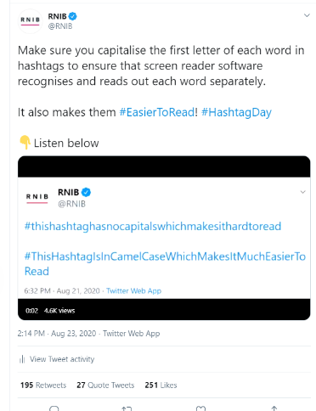
Twitter
Best for news, reactions and regular updates.
Make it sharable by adding something to the conversation: say something new or interesting.
Stats, quotes, media, links and hashtags all encourage engagement.
Less emphasis on storytelling. Great for direct asks, but mix it up.
Threads good for long form responses.
Pin strongest piece of content.
Twitter feed less algorithm-led, so timing is key.
Great for amplifying others.
Notes:
At RNIB we tweet up to 8 times per day.

Slide 17

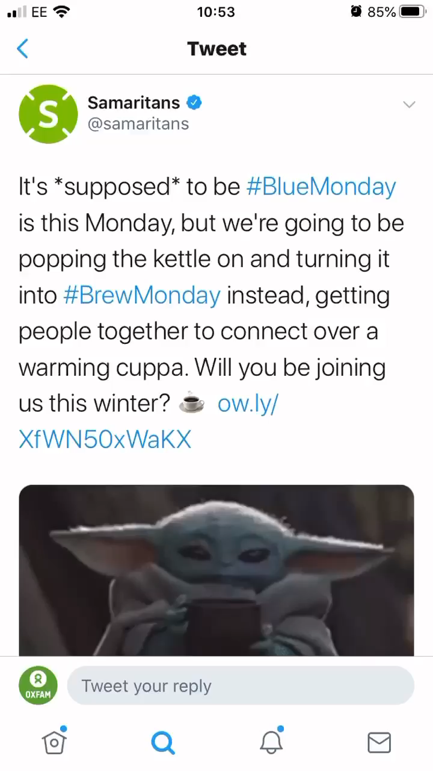
Hashtags
Avoid on Facebook
Relevant to the topic not the brand
Max 2 on Twitter, 30 for Instagram (in comments)
Use CamelCase
Notes:
Can use them, like Samartians, to give your fundraiser an identity and encourage audience participation
https://twitter.com/samaritans/status/1217492006274043904

Slide 18
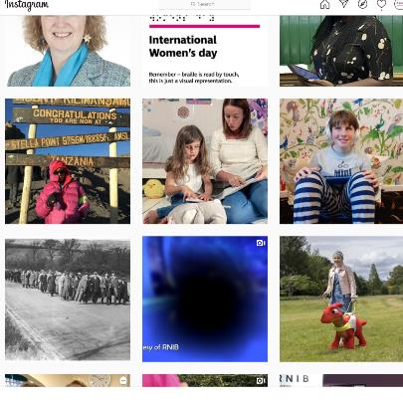
Instagram Grid
Image led
Storytelling
Community focused
Notes:
Difficult to link from posts, so choose your organisational priority and put that link in your bio. It is hard to drive traffic from Instagram Grid so focus on building an engaged community, showing your impact etc.

Slide 19
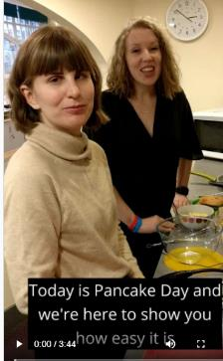
IGTV
Videos 1h long
Portrait
If you are posting on IGTV it will appear bigger in the Explore page.
Notes:
Explore page means connecting new people with your cause: new potential donors etc.

Slide 20
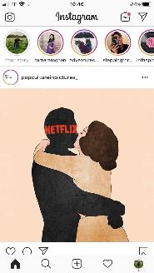
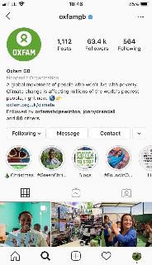
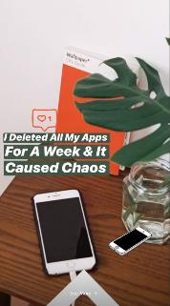
Stories
500 million daily users
Swipe up link if over 10k followers
It’s good for raw, behind the scenes content from fundraising events and very good for UGC
No alt text for image descriptions, so include a voiceover for accessibility

Slide 21
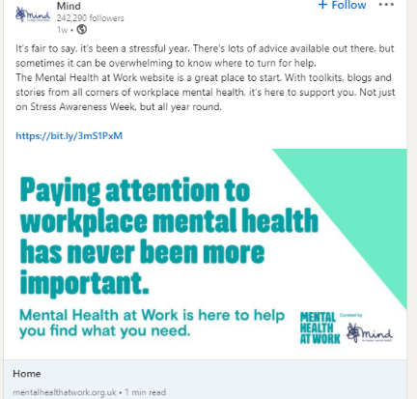
LinkedIn
85% of all page views are now content, and not jobs
Stats, stories, impact
Hashtags and @ mentions
Use clear calls to action: view, watch, learn, listen, download, register, apply
Individual-individual communication is more authentic than brand-individual: focus on employee and volunteer advocacy.
Notes:
Content shared by employees receives 8x more engagement vs. same content shared by companies > remember as well as employees to use Trustee, volunteer, community voices.
At RNIB we aim for 2 posts a week on Linkedin.

Slide 22
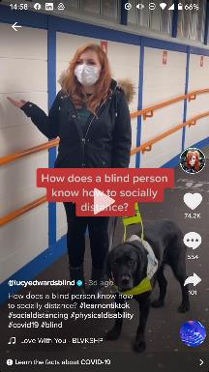
TikTok
TikTok is a hub for creativity, expression and humour.
Portrait video, text, effects and music.
Driven by interests rather than who you are following. Served with videos selected for you.
Notes:
Use TikTok to engage, entertain and motivate people to fundraise/donate.
Red Cross are doing great things – celeb fundraisers: Lewis Capaldi

Slide 23
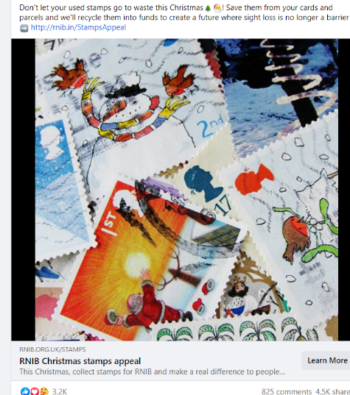
Paid Social
Facebook
Instagram
Twitter
LinkedIn
YouTube
Notes:
While organic social is all about engagement, paid is all about conversions.
Using advertising on social media allows us to reach larger audiences, different people and highly targeted groups.
Explain prospecting and retargeting.
FAcebook most affordable, best targeting, easiest platform to manage.
UGC content working better for us than polished graphics: photos better than text-led in terms of statics. Short and sweet copy.
Small budget versus large: boosting Facebook posts to reach more people.

Slide 24
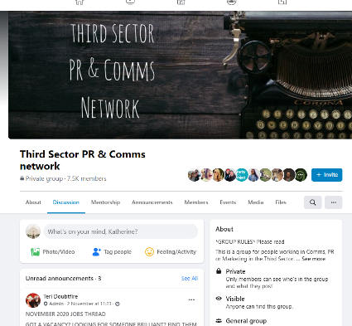
Free tools and resources
Headliner for editing videos
Canva for producing graphics
Facebook Blueprint: free courses to learn about adverts
Google Garage: free digital marketing courses
Facebook Groups: Third Sector Comms and PR, Fundraising Chat, The Social Media Geekout.
Newsletters: Dimple’s Digital Digest, Matt Navarra.
Google Grants for nonprofits: https://www.google.co.uk/grants/
Virtual events sector research: https://wearemassive.co.uk/the-virtual-fundraising-monitor/

Slide 25
Thank you for listening. Any questions?

